Slide 1
Lect-3 UML
Object Oriented Analysis and Design
Modeling with UML

Slide 2
What is modeling?
Modeling consists of building an abstraction of reality.
Abstractions are simplifications because:
  They ignore irrelevant details and
  They only represent the relevant details.
What is relevant or irrelevant depends on the purpose of the model.

Slide 3
Systems, Models and Views
A model is an abstraction describing a subset of a system
A view depicts selected aspects of a model
A notation is a set of graphical or textual rules for depicting views
Views and models of a single system may overlap each other
Examples:
System: Aircraft
Models: Flight simulator, scale model
Views: All blueprints, electrical wiring, fuel system

Slide 4
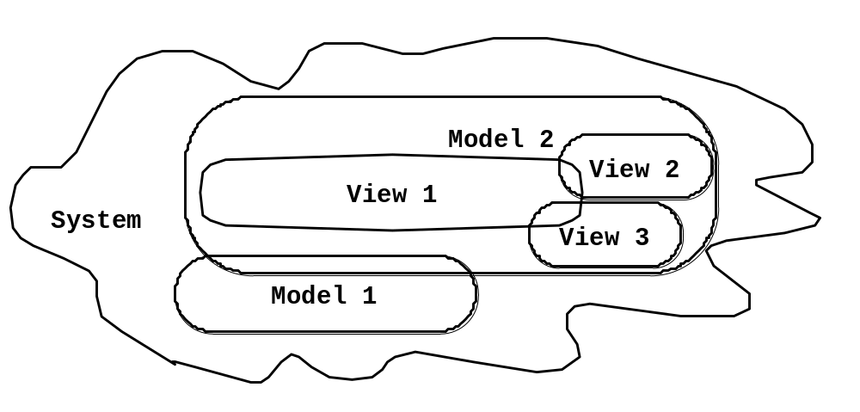
Systems, Models and Views
Flightsimulator
Blueprints
Aircraft
Electrical
Wiring
Scale Model

Slide 5
Concepts and phenomena
Name
Purpose
Members
Clock
A device that
measures time.
Abstraction
  Classification of phenomena into concepts
Modeling
  Development of abstractions to answer specific questions about a set of phenomena while ignoring irrelevant details.

Slide 6
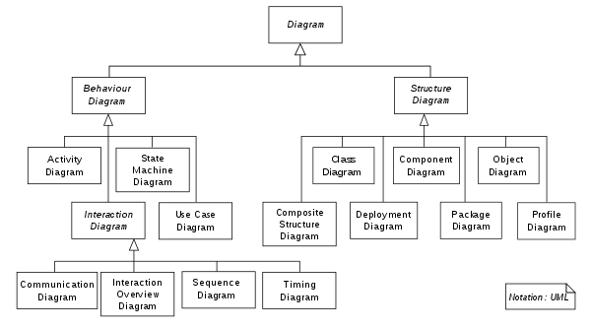
What is UML?

Slide 7
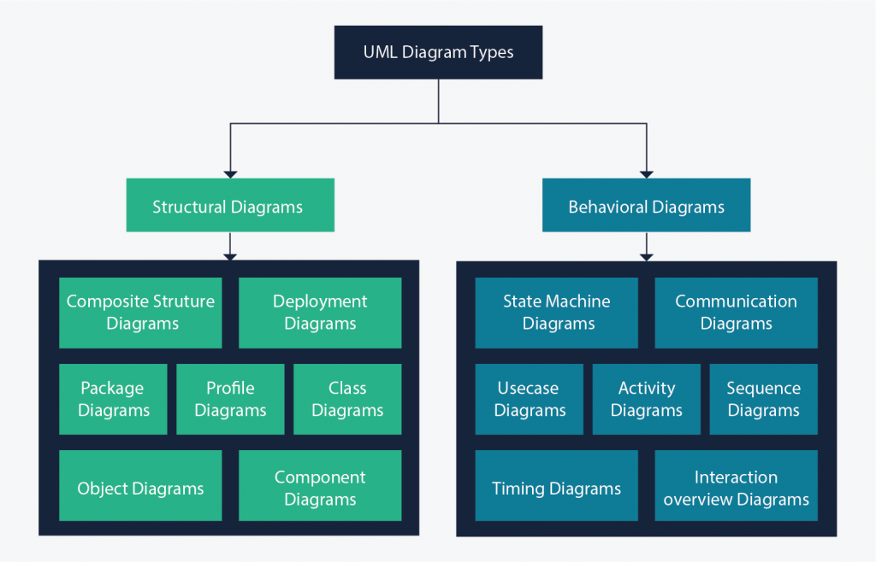


Slide 8
What is UML?
Unified Modeling Language, is a standardized modeling language consisting of an integrated set of diagrams, developed to help system and software developers for specifying, visualizing, constructing, and documenting the artifacts of software systems, as well as for business modeling and other non-software systems.
The UML represents a collection of best engineering practices that have proven successful in the modeling of large and complex systems.
The UML is a very important part of developing object oriented software and the software development process.
The UML uses mostly graphical notations to express the design of software projects.

Slide 9
Using the UML helps project teams communicate, explore potential designs, and validate the architectural design of the software.
The goal of UML is to provide a standard notation that can be used by all object-oriented methods and to select and integrate the best elements of precursor notations.
UML has been designed for a broad range of applications.
Hence, it provides constructs for a broad range of systems and activities (e.g., distributed systems, analysis, system design and deployment).

Slide 10
UML is a notation that resulted from the unification of OMT
Object Modeling Technique OMT [James Rumbaugh 1991] - was best for analysis and data-intensive information systems.
Booch [Grady Booch 1994] - was excellent for design and implementation. Grady Booch had worked extensively with the Ada language, and had been a major player in the development of Object Oriented techniques for the language. Although the Booch method was strong, the notation was less well received (lots of cloud shapes dominated his models - not very tidy)
OOSE (Object-Oriented Software Engineering [Ivar Jacobson 1992]) - featured a model known as Use Cases. Use Cases are a powerful technique for understanding the behaviour of an entire system (an area where OO has traditionally been weak)

Slide 11
Why UML
Provide users with a ready-to-use, expressive visual modeling language so they can develop and exchange meaningful models.
Provide extensibility and specialization mechanisms to extend the core concepts.
Be independent of particular programming languages and development processes.
Provide a formal basis for understanding the modeling language.
Encourage the growth of the OO tools market.
Support higher-level development concepts such as collaborations, frameworks, patterns and components.
Integrate best practices.
Notes:
All of these people are interested in different aspects of the system, and each of them require a different level of detail. For example, a coder needs to understand the design of the system and be able to convert the design to a low level code. By contrast, a technical writer is interested in the behavior of the system as a whole, and needs to understand how the product functions. The UML attempts to provide a language so expressive that all stakeholders can benefit from at least one UML diagram.

Slide 12
In UML there are a lot of different diagrams (models) to get used to.
The reason for this is that it is possible to look at a system from many different viewpoints. A software development will have many stakeholders playing a part.For Example:
Analysts
Designers
Coders
Tester s/ QA
The Customer
Technical Authors
All of these people are interested in different aspects of the system, and each of them require a different level of detail. For example, a coder needs to understand the design of the system and be able to convert the design to a low level code. By contrast, a technical writer is interested in the behavior of the system as a whole, and needs to understand how the product functions. The UML attempts to provide a language so expressive that all stakeholders can benefit from at least one UML diagram.

Slide 13
Structure diagrams show the static structure of the system and its parts on different abstraction and implementation levels and how they are related to each other. The elements in a structure diagram represent the meaningful concepts of a system, and may include abstract, real world and implementation concepts, there are seven types of structure diagram as follows:
Class Diagram
Component Diagram
Deployment Diagram
Object Diagram
Package Diagram
Composite Structure Diagram
Profile Diagram

Slide 14
Behavior diagrams show the dynamic behavior of the objects in a system, which can be described as a series of changes to the system over time, there are seven types of behavior diagrams as follows:
Use Case Diagram
Activity Diagram
State Machine Diagram
Sequence Diagram
Communication Diagram
Interaction Overview Diagram
Timing Diagram

Slide 15
UML First Pass
Use case Diagrams
  Describe the functional behavior of the system as seen by the user.
Class diagrams
  Describe the static structure of the system: Objects, Attributes, Associations
Sequence diagrams
  Describe the dynamic behavior between actors and the system and between objects of the system
Statechart diagrams
  Describe the dynamic behavior of an individual object (essentially a finite state automaton)
Activity Diagrams
  Model the dynamic behavior of a system, in particular the workflow (essentially a flowchart)

Slide 16
UML - An Overview
Before we begin to look at the theory of the UML, we are going to take a very brief run through some of the major concepts of the UML.
The first thing to notice about the UML is that there are a lot of different diagrams (models) to get used to. The reason for this is that it is possible to look at a system from many different viewpoints. A software development will have many stakeholders playing a part.
For Example:
Analysts
Designers
Coders
Testers
QA
The Customer
Technical Authors

Slide 17

Overview of UML Diagrams
Behavioral: behavioral features of a system / business process
Activity
State machine
Use case
Interaction
Structural : element of spec. irrespective of time
Class
Component
Deployment
Object
Composite structure
Package
Interaction: emphasize object interaction
Communication(collaberation)
Sequence
Interaction overview
Timing

Slide 18
What is a Class Diagram?
The class diagram is a central modeling technique that runs through nearly all object-oriented methods. This diagram describes the types of objects in the system and various kinds of static relationships which exist between them.
Relationships
There are three principal kinds of relationships which are important:
Association - represent relationships between instances of types (a person works for a company, a company has a number of offices.
Inheritance - the most obvious addition to ER diagrams for use in OO. It has an immediate correspondence to inheritance in OO design.
Aggregation - Aggregation, a form of object composition in object-oriented design.

Slide 19
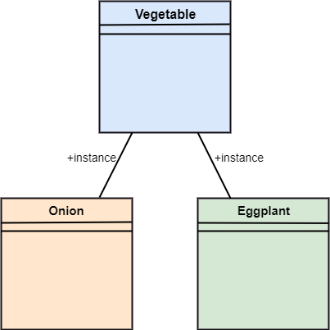
What is an Reflexive Association?
In the reflexive associations, the links are between the objects of the same classes. In other words, it can be said that the reflexive association consists of the same class at both ends. An object can also be termed as an instance.
Let's have a look at its example of a class vegetable. The vegetable class has two objects, i.e., onion and eggplant. According to the reflexive association's definition, the link between the onion and eggplant exist, as they belong to the same class, i.e., vegetable

Slide 20
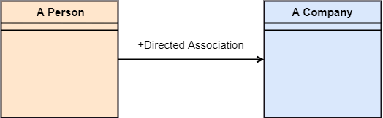
What is an Directed Association?
The directed association is concerned with the direction of flow inside association classes. The flow of association can be shown by employing a directed association. The directed association between two classes is represented by a line with an arrowhead, which indicates the navigation direction. The flow of association from one class to another is always in one direction.
It can be said that there is an association between a person and the company. The person works for the company. Here the person works for the company, and not the company works for a person

Slide 21
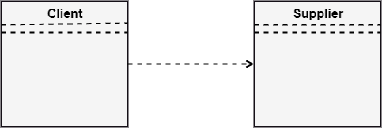
UML-Dependency
Dependency depicts how various things within a system are dependent on each other. In UML, a dependency relationship is the kind of relationship in which a client (one element) is dependent on the supplier (another element). It is used in class diagrams, component diagrams, deployment diagrams, and use-case diagrams, which indicates that a change to the supplier necessitates a change to the client. An example is given below:

Slide 22
Types of Dependency Relationship
<<use>> -When the packages are created in UML, the use of stereotype is used as it describes that the elements of the source package can also exist in the target package. It specifies that the source package uses some of the elements of the target package.
<<access>> -It is also called as private merging in which the source package accesses the element of the target package.
<<import>> -It specifies that target imports the source package's element as they are defined within the target. It is also known as public merging.
<<permit>> -It describes that the source element can access the supplier element or whatever visibility is provided by the supplier.
<<extend>> -It states that the behavior of the source element can be extended by the target.
<<include>> -It describes the source element, which can include the behavior of another element at a specific location, just like a function call in C/C++.

Slide 23
UML-Generalization
In UML modeling, a generalization relationship is a relationship that implements the concept of object orientation called inheritance. The generalization relationship occurs between two entities or objects, such that one entity is the parent, and the other one is the child. The child inherits the functionality of its parent and can access as well as update it.
Generalization relationship is utilized in class, component, deployment, and use case diagrams to specify that the child inherits actions, characteristics, and relationships from its parent.
To meet UML's standard, it necessitates usage of the same types of model elements in the generalization relationship, i.e., generalization relation can either be used between actors or between use cases, but not between an actor and a use case.
The generalization relationship is incorporated to record attributes, operations, and relationships in a parent model element so that it can be inherited in one or more child model elements.
The parent model element can have as many children, and also, the child can have one or more parents. But most commonly, it can be seen that there is one parent model element and multiple child model elements. The generalization relationship does not consist of names. The generalization relationship is represented by a solid line with a hollow arrowhead pointing towards the parent model element from the child model element.

Slide 24
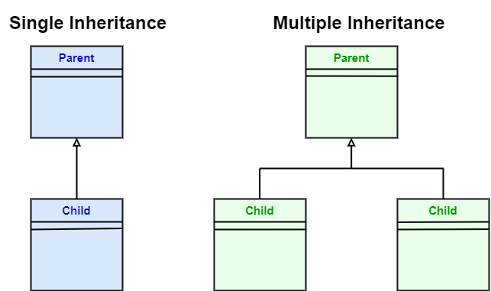
UML-Generalization

Slide 25
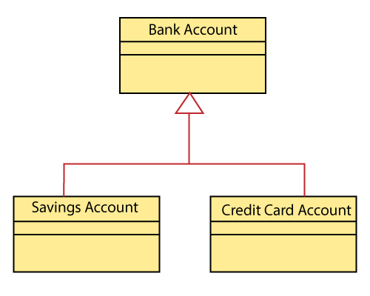
Stereotypes and their constraints
<<implementation>> - It is used to show that the child is implemented by its parent, such that the child object inherits the structure and behavior of its parent object without disobeying the rules. The implementation of stereotype is mostly used in single inheritance.
In the generalization stereotype, there are two types of constraints that are complete and incomplete to check if all the child objects are involved or not in the relationship.
Example: As we know, the bank account can be of two types; Savings Account and Credit Card Account. Both the savings and the credit card account inherits the generalized properties from the Bank Account, which is Account Number, Account Balance, etc.

Slide 26

Relationships
In UML, relationships are of three types:
Dependency: A dependency is a semantic relationship between two or more classes where a change in one class cause changes in another class. It forms a weaker relationship.
In the following example, Student_Name is dependent on the Student_I

Slide 27
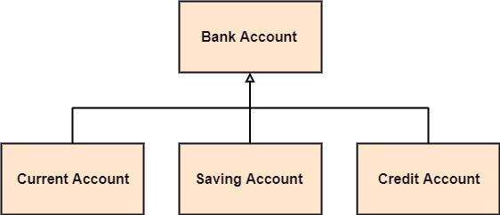
Relationships
Generalization: A generalization is a relationship between a parent class (superclass) and a child class (subclass). In this, the child class is inherited from the parent class.
For example, The Current Account, Saving Account, and Credit Account are the generalized form of Bank Account.

Slide 28

Association: It describes a static or physical connection between two or more objects. It depicts how many objects are there in the relationship.
For example, a department is associated with the college.

Slide 29

Association
Unidirectional association - In a unidirectional association, two classes are related, but only one class knows that the relationship exists.
A unidirectional association is drawn as a solid line with an open arrowhead pointing to the known class.

Slide 30

Bidirectional (standard) association - An association is a linkage between two classes. Associations are always assumed to be bi-directional; this means that both classes are aware of each other and their relationship, unless you qualify the association as some other type.
A bi-directional association is indicated by a solid line between the two classes.

Slide 31
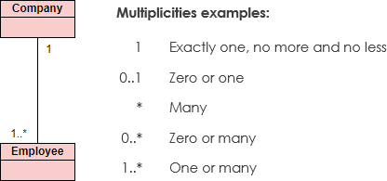
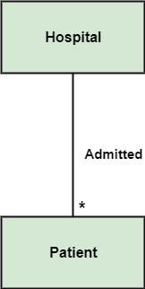
Multiplicity: It defines a specific range of allowable instances of attributes. In case if a range is not specified, one is considered as a default multiplicity.
For example, For example, one company will have one or more employees, but each employee works for one company only.
multiple patients are admitted to one hospital.

Slide 32

Aggregation: An aggregation is a subset of association, which represents has a relationship. It is more specific then association. It defines a part-whole or part-of relationship. In this kind of relationship, the child class can exist independently of its parent class.
The company encompasses a number of employees, and even if one employee resigns, the company still exists.

Slide 33

Composition: The composition is a subset of aggregation. It portrays the dependency between the parent and its child, which means if one part is deleted, then the other part also gets discarded. It represents a whole-part relationship.
A contact book consists of multiple contacts, and if you delete the contact book, all the contacts will be lost.

Slide 34
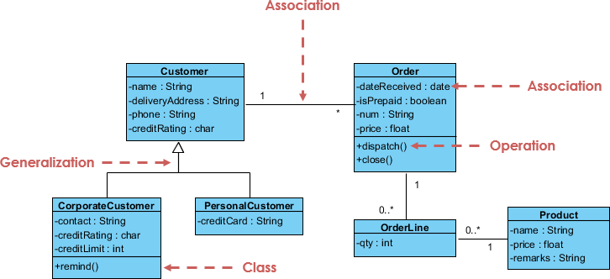

Slide 35
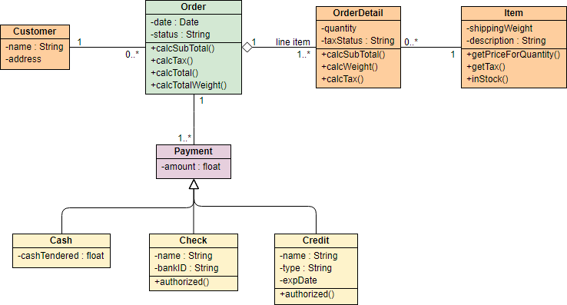
Example – class diagram

Slide 36
UML first pass: Use case diagrams
Package
Use case
Watch
Actor
ReadTime
WatchUser
SetTime
WatchRepairPerson
ChangeBattery
Use case diagrams represent the functionality of the system
from user’s point of view. Rectangles are classes or instances
Ovals are functions or use cases
Instances are denoted with an underlined names

Slide 37

Use cases diagram
UML 2 Use cases diagrams describes the behavior of the target system from an external point of view. Use cases describe "the meat" of the actual requirements.
Use cases. A use case describes a sequence of actions that provide something of measurable value to an actor and is drawn as a horizontal ellipse.
Actors. An actor is a person, organization, or external system that plays a role in one or more interactions with your system. Actors are drawn as stick figures.
Associations. Associations between actors and use cases are indicated by solid lines. An association exists whenever an actor is involved with an interaction described by a use case.

Slide 38
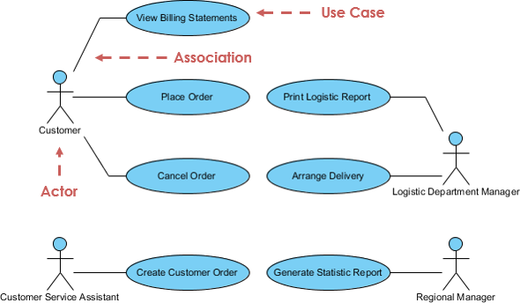
Use cases diagram

Slide 39
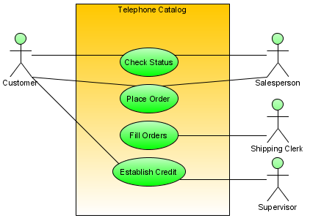
Use cases diagram
Notes:
Dashed oval : collaboration , rectangular : instances of any type of classifier, including classes, objects, or interfaces

Slide 40
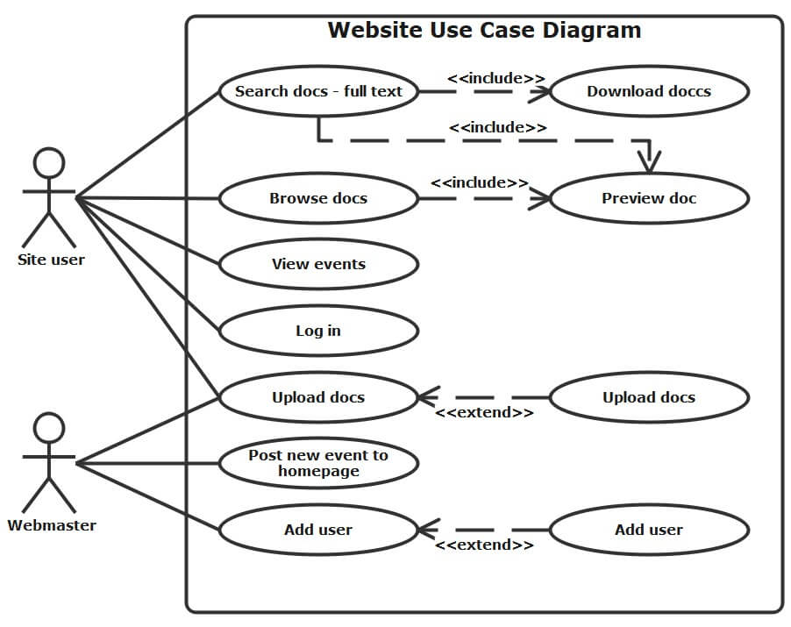
Website Use case Diagram

Slide 41
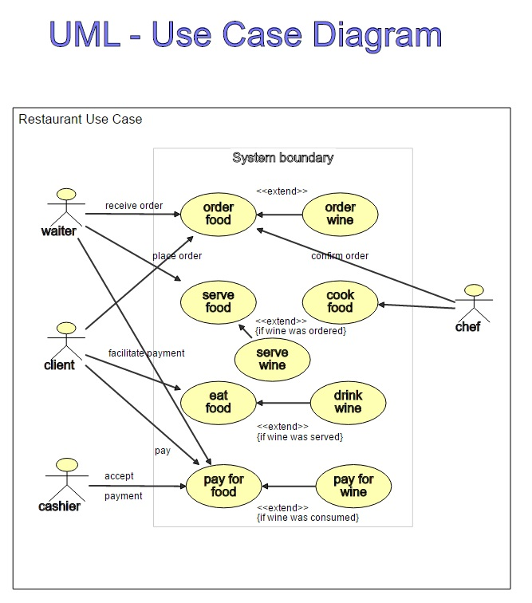
Restaurant use case diagram

Slide 42
A use-case model describes a system's functional requirements in terms of use cases. It is a model of the system's intended functionality (use cases) and its environment (actors). Use cases enable you to relate what you need from a system to how the system delivers on those needs.
Think of a use-case model as a menu, much like the menu you'd find in a restaurant. By looking at the menu, you know what's available to you, the individual dishes as well as their prices. You also know what kind of cuisine the restaurant serves: Italian, Mexican, Chinese, and so on. By looking at the menu, you get an overall impression of the dining experience that awaits you in that restaurant. The menu, in effect, "models" the restaurant's behavior.
Because it is a very powerful planning instrument, the use-case model is generally used in all phases of the development cycle by all team members.

Slide 43
Object diagram
UML 2 Object diagrams (instance diagrams), are useful for exploring real world examples of objects and the relationships between them. It shows instances instead of classes. They are useful for explaining small pieces with complicated relationships, especially recursive relationships.
An object diagram is a graph of instances, including objects and data values. A static object diagram is an instance of a class diagram; it shows a snapshot of the detailed state of a system at a point in time. The difference is that a class diagram represents an abstract model consisting of classes and their relationships.

Slide 44
However, an object diagram represents an instance at a particular moment, which is concrete in nature. The use of object diagrams is fairly limited, namely to show examples of data structure.
Class Diagram vs Object Diagram - An Example
Some people may find it difficult to understand the difference between a UML Class Diagram and a UML Object Diagram as they both comprise of named "rectangle blocks", with attributes in them, and with linkages in between, which make the two UML diagrams look similar. Some people may even think they are the same because in the UML tool they use both the notations for Class Diagram and Object Diagram are put inside the same diagram editor - Class Diagram.
But in fact, Class Diagram and Object Diagram represent two different aspects of a code base. In this article, we will provide you with some ideas about these two UML diagrams, what they are, what are their differences and when to use each of them.

Slide 45
Relationship between Class Diagram and Object Diagram
You create "classes" when you are programming. For example, in an online banking system you may create classes like 'User', 'Account', 'Transaction', etc. In a classroom management system you may create classes like 'Teacher', 'Student', 'Assignment', etc. In each class, there are attributes and operations that represent the characteristic and behavior of the class. Class Diagram is a UML diagram where you can visualize those classes, along with their attributes, operations and the inter-relationship.
UML Object Diagram shows how object instances in your system are interacting with each other at a particular state. It also represents the data values of those objects at that state. In other words, a UML Object Diagram can be seen as a representation of how classes (drawn in UML Class Diagram) are utilized at a particular state.
If you are not a fan of those definition stuff, take a look at the following UML diagram examples. I believe that you will understand their differences in seconds.

Slide 46
UML Class Diagram
The class diagram depicts a static view of an application. It represents the types of objects residing in the system and the relationships between them. A class consists of its objects, and also it may inherit from other classes. A class diagram is used to visualize, describe, document various different aspects of the system, and also construct executable software code.
It shows the attributes, classes, functions, and relationships to give an overview of the software system. It constitutes class names, attributes, and functions in a separate compartment that helps in software development. Since it is a collection of classes, interfaces, associations, collaborations, and constraints, it is termed as a structural diagram.

Slide 47
Purpose of Class Diagrams
The main purpose of class diagrams is to build a static view of an application. It is the only diagram that is widely used for construction, and it can be mapped with object-oriented languages. It is one of the most popular UML diagrams. Following are the purpose of class diagrams given below:
It analyses and designs a static view of an application.
It describes the major responsibilities of a system.
It is a base for component and deployment diagrams.
It incorporates forward and reverse engineering.

Slide 48
Benefits of Class Diagrams
It can represent the object model for complex systems.
It reduces the maintenance time by providing an overview of how an application is structured before coding.
It provides a general schematic of an application for better understanding.
It represents a detailed chart by highlighting the desired code, which is to be programmed.
It is helpful for the stakeholders and the developers.

Slide 49
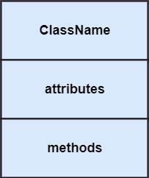
Vital components of a Class Diagram
The class diagram is made up of three sections:
Upper Section: The upper section encompasses the name of the class. A class is a representation of similar objects that shares the same relationships, attributes, operations, and semantics. Some of the following rules that should be taken into account while representing a class are given below:
  Capitalize the initial letter of the class name.
  Place the class name in the center of the upper section.
  A class name must be written in bold format.
  The name of the abstract class should be written in italics format.
Middle Section: The middle section constitutes the attributes, which describe the quality of the class. The attributes have the following characteristics:
  The attributes are written along with its visibility factors, which are public (+), private (-), protected (#), and package (~).
  The accessibility of an attribute class is illustrated by the visibility factors.
  A meaningful name should be assigned to the attribute, which will explain its usage inside the class.
Lower Section: The lower section contain methods or operations. The methods are represented in the form of a list, where each method is written in a single line. It demonstrates how a class interacts with data.

Slide 50
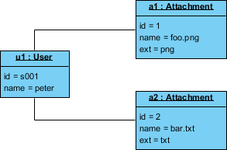

Class Diagram Example
The following Class Diagram example represents two classes - User and Attachment. A user can upload multiple attachment so the two classes are connected with an association, with 0..* as multiplicity on the Attachment side.
Object Diagram Example
The following Object Diagram example shows you how the object instances of User and Attachment class "look like" at the moment Peter (i.e. the user) is trying to upload two attachments. So there are two Instance Specification for the two attachment objects to be uploaded.

Slide 51
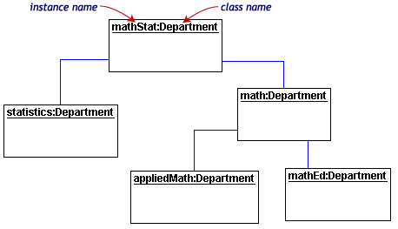
Object diagram

Slide 52
Activity diagram
UML 2 Activity diagrams helps to describe the flow of control of the target system, such as the exploring complex business rules and operations, describing the use case also the business process. It is object-oriented equivalent of flow charts and data-flow diagrams (DFDs).

Slide 53
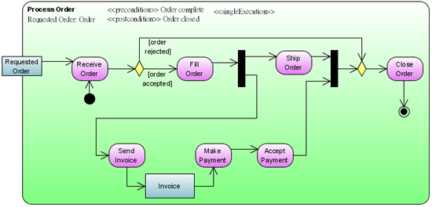
Activity diagram
Notes:
Dashed oval : collaboration , rectangular : instances of any type of classifier, including classes, objects, or interfaces

Slide 54
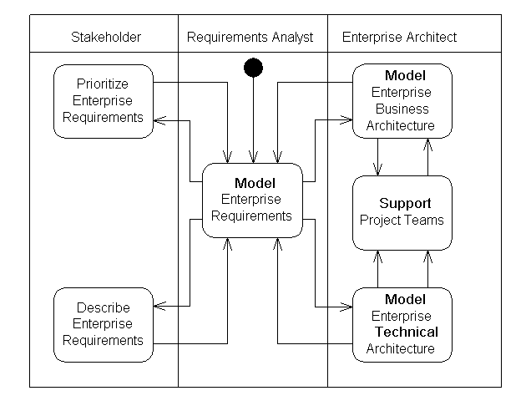
Activity diagram
Notes:
A swimlane is a way to group activities performed by the same actor on an activity diagram or to group activities in a single thread.

Slide 55
State machine diagram
A state diagram is a type of diagram used in UML to describe the behavior of systems which is based on the concept of state diagrams by David Harel.
State diagrams depict the permitted states and transitions as well as the events that effect these transitions.
It helps to visualize the entire lifecycle of objects and thus help to provide a better understanding of state-based system UML 2
State machine diagrams can show the different states of an entity also how an entity responds to various events by changing from one state to another.
The history of an entity can best be modeled by a finite state diagram.

Slide 56
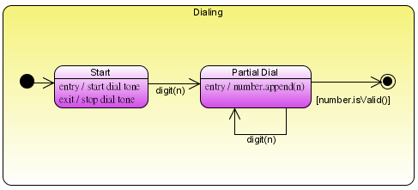
State machine diagram
Notes:
Dashed oval : collaboration , rectangular : instances of any type of classifier, including classes, objects, or interfaces

Slide 57
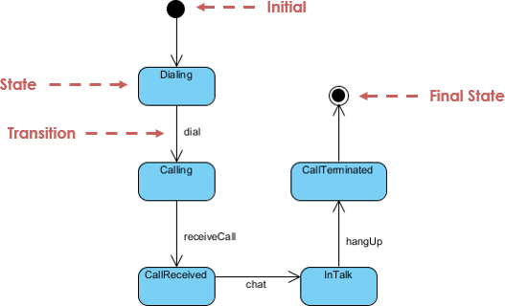
State machine diagram

Slide 58
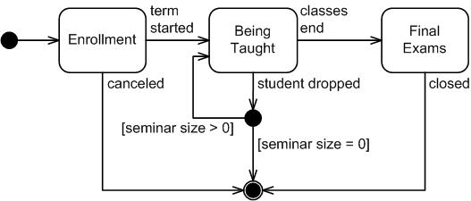
State machine diagram

Slide 59
UML - Interaction Diagrams
From the term Interaction, it is clear that the diagram is used to describe some type of interactions among the different elements in the model. This interaction is a part of dynamic behavior of the system.
This interactive behavior is represented in UML by two diagrams known as Sequence diagram and Collaboration diagram. The basic purpose of both the diagrams are similar.
Sequence diagram emphasizes on time sequence of messages and collaboration diagram emphasizes on the structural organization of the objects that send and receive messages

Slide 60
Sequence Diagram
The Sequence Diagram models the collaboration of objects based on a time sequence. It shows how the objects interact with others in a particular scenario of a use case.
With the advanced visual modeling capability, you can create complex sequence diagram in few clicks.
Besides, some modeling tool such as Visual Paradigm can generate sequence diagram from the flow of events which you have defined in the use case description.
UML Sequence diagrams models the collaboration of objects based on a time sequence. It shows how the objects interact with others in a particular scenario of a use case.

Slide 61
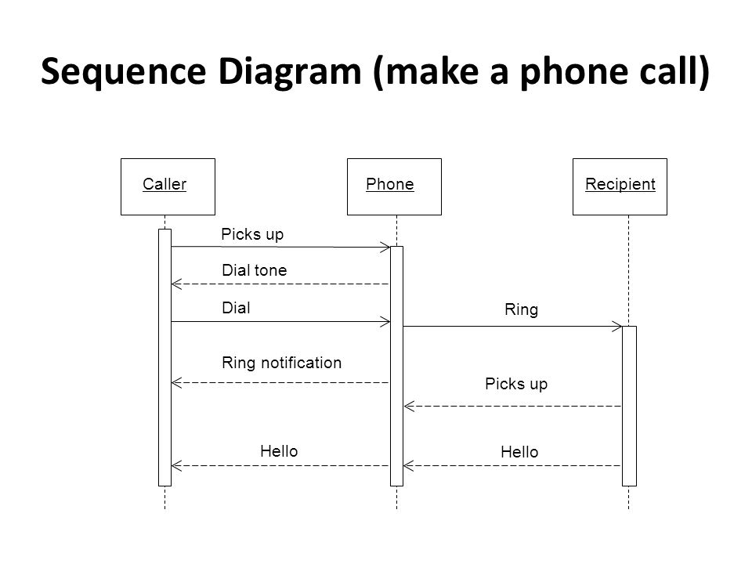
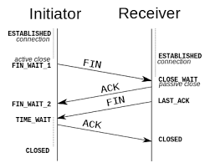

Slide 62
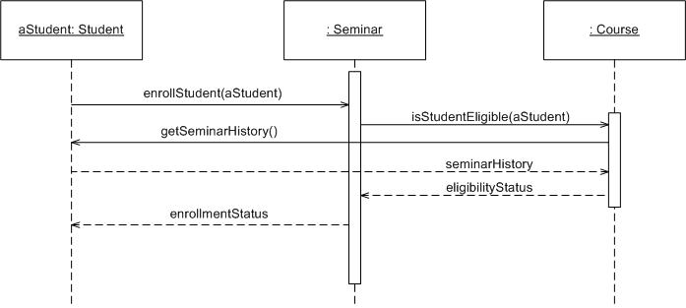
Sequence diagram
Notes:
Dashed oval : collaboration , rectangular : instances of any type of classifier, including classes, objects, or interfaces

Slide 63
UML Glossary and Terms
Abstract Class - A class that will never be instantiated. An instance of this class will never exist.
Actor - An object or person that initiates events the system is involved with.
Activity: A step or action within an Activity Diagram. Represents an action taken by the system or by an Actor.
Activity Diagram: A glorified flowchart that shows the steps and decisions and parallel operations within a process, such as an algorithm or a business process.
Aggregation - Is a part of another class. Shown with a hollow diamond next to the containing class in diagrams.
Artifacts - Documents describing the output of a step in the design process. The description is graphic, textual, or some combination.
Association - A connection between two elements of a Model. This might represent a member variable in code, or the association between a personnel record and the person it represents, or a relation between two categories of workers, or any similar relationship. By default, both elements in an Association are equal, and are aware of each other through the Association. An Association can also be a Navigable Association, meaning that the source end of the association is aware of the target end, but not vice versa.

Slide 64
UML Glossary and Terms
Association Class: A Class that represents and adds information to the Association between two other Classes.
Attributes - Characteristics of an object which may be used to reference other objects or save object state information.
Base Class: A Class which defines Attributes and Operations that are inherited by a Subclass via a Generalization relationship.
Branch: A decision point in an Activity Diagram. Multiple Transitions emerge from the Branch, each with a Guard Condition. When control reaches the Branch, exactly one Guard Condition must be true; and control follows the corresponding Transition.
Class: A category of similar Objects, all described by the same Attributes and Operations and all assignment-compatible.
Class Diagram - Shows the system classes and relationships between them.
Classifier: A UML element that has Attributes and Operations. Specifically, Actors, Classes, and Interfaces.
Collaboration: A relation between two Objects in a Communication Diagram, indicating that Messages can pass back and forth between the Objects.
Communication Diagram - A diagram that shows how operations are done while emphasizing the roles of objects.

Slide 65
UML Glossary and Terms
Concept - A noun or abstract idea to be included in a domain model.
Construction Phase - The third phase of the Rational Unified Process during which several iterations of functionality are built into the system under construction. This is where the main work is done.
Dependence: A relationship that indicates one Classifier knows the Attributes and Operations of another Classifier, but isn't directly connected to any instance of the second Classifier.
Deployment Diagram: A diagram that shows relations between various Processors.
Domain -The part of the universe that the system is involved with.
Elaboration Phase - The second phase of the Rational Unified Process that allows for additional project planning including the iterations of the construction phase.
Element: Any item that appears in a Model.
Encapsulation - Data in objects is private.
Generalization - Indicates that one class is a subclass on another class (superclass). A hollow arrow points to the superclass.
Event: In a State Diagram, this represents a signal or event or input that causes the system to take an action or switch States.
Final State: In a State Diagram or an Activity Diagram, this indicates a point at which the diagram completes.

Slide 66

UML Glossary and Terms
Fork: A point in an Activity Diagram where multiple parallel control threads begin.
Generalization: An inheritance relationship, in which a Subclass inherits and adds to the Attributes and Operations of a Base Class.
GoF - Gang of Four set of design patterns.
High Cohesion - A GRASP evaluative pattern which makes sure the class is not too complex, doing unrelated functions.
Low Coupling - A GRASP evaluative pattern which measures how much one class relies on another class or is connected to another class.
Inception Phase - The first phase of the Rational Unified Process that deals with the original conceptualization and beginning of the project.
Inheritance - Subclasses inherit the attributes or characterics of their parent (superclass) class. These attributes can be overridden in the subclass.
Initial State: In a State Diagram or an Activity Diagram, this indicates the point at which the diagram begins.
Instance - A class is used like a template to create an object. This object is called an instance of the class. Any number of instances of the class may be created.
Interface: A Classifier that defines Attributes and Operations that form a contract for behavior. A provider Class or Component may elect to Realize an Interface (i.e., implement its Attributes and Operations). A client Class or Component may then Depend upon the Interface and thus use the provider without any details of the true Class of the provider.

Slide 67
UML Glossary and Terms
Iteration - A mini project section during which some small piece of functionality is added to the project. Includes the development loop of analysis, design and coding.
Join: A point in an Activity Diagram where multiple parallel control threads synchronize and rejoin.
Member: An Attribute or an Operation within a Classifier.
Merge: A point in an Activity Diagram where different control paths come together.
Message - A request from one object to another asking the object receiving the message to do something. This is basically a call to a method in the receiving object.
Method - A function or procedure in an object.
Model - The central UML artifact. Consists of various elements arranged in a hierarchy by Packages, with relations between elements as well.
Multiplicity - Shown in a domain model and indicated outside concept boxes, it indicates object quantity relationship to quantiles of other objects.
Navigability: Indicates which end of a relationship is aware of the other end. Relationships can have bidirectional Navigability (each end is aware of the other) or single directional Navigability (one end is aware of the other, but not vice versa).
Notation - Graphical document with rules for creating analysis and design methods.

Slide 68
UML Glossary and Terms
Note: A text note added to a diagram to explain the diagram in more detail.
Object - Object: In an Activity Diagram, an object that receives information from Activities or provides information to Activities. In a Collaboration Diagram or a Sequence Diagram, an object that participates in the scenario depicted in the diagram. In general: one instance or example of a given Classifier (Actor, Class, or Interface).
Package - A group of UML elements that logically should be grouped together.
Package Diagram: A Class Diagram in which all of the elements are Packages and Dependencies.
Pattern - Solutions used to determine responsibility assignment for objects to interact. It is a name for a successful solution to a well-known common problem.
Parameter: An argument to an Operation.
Polymorphism - Same message, different method. Also used as a pattern.
Private: A Visibility level applied to an Attribute or an Operation, indicating that only code for the Classifier that contains the member can access the member.
Processor: In a Deployment Diagram, this represents a computer or other programmable device where code may be deployed.

Slide 69
UML Glossary and Terms
Protected: A Visibility level applied to an Attribute or an Operation, indicating that only code for the Classifier that contains the member or for its Subclasses can access the member.
Public: A Visibility level applied to an Attribute or an Operation, indicating that any code can access the member.
Reading Direction Arrow - Indicates the direction of a relationship in a domain model.
Realization: Indicates that a Component or a Class provides a given Interface.
Role - Used in a domain model, it is an optional description about the role of an actor.
Sequence Diagram: A diagram that shows the existence of Objects over time, and the Messages that pass between those Objects over time to carry out some behavior. State chart diagram - A diagram that shows all possible object states.
State: In a State Diagram, this represents one state of a system or subsystem: what it is doing at a point in time, as well as the values of its data.
State Diagram: A diagram that shows States of a system or subsystem, Transitions between States, and the Events that cause the Transitions.
Static: A modifier to an Attribute to indicate that there's only one copy of the Attribute shared among all instances of the Classifier. A modifier to an Operation to indicate that the Operation stands on its own and doesn't operate on one specific instance of the Classifier.

Slide 70
UML Glossary and Terms
Stereotype: A modifier applied to a Model element indicating something about it which can't normally be expressed in UML. In essence, Stereotypes allow you to define your own "dialect" of UML.
Subclass: A Class which inherits Attributes and Operations that are defined by a Subclass via a Generalization relationship.
Swimlane: An element of an Activity Diagram that indicates what parts of a system or a domain perform particular Activities. All Activities within a Swimlane are the responsibility of the Object, Component, or Actor represented by the Swimlane.
Time Boxing - Each iteration will have a time limit with specific goals.
Transition: In an Activity Diagram, represents a flow of control from one Activity or Branch or Merge or Fork or Join to another. In a State Diagram, represents a change from one State to another.
Transition Phase - The last phase of the Rational Unified Process during which users are trained on using the new system and the system is made available to users.
UML - Unified Modeling Language utilizes text and graphic documents to enhance the analysis and design of software projects by allowing more cohesive relationships between objects.
Use Case: In a Use Case Diagram, represents an action that the system takes in response to some request from an Actor.
Use Case Diagram: A diagram that shows relations between Actors and Use Cases.
Visibility: A modifier to an Attribute or Operation that indicates what code has access to the member. Visibility levels include Public, Protected, and Private.
Workflow - A set of activities that produces some specific result.

